Slide 1
Gencyber Grizzly Summer Institute
Day 5.2 Pattern Matching

Slide 2

Verifying Messages
What is Antivirus?
What do these do?
This Photo by Unknown Author is licensed under CC BY-SA-NC

Slide 3
How Does Antivirus Work?
How do you think antivirus can find malicious software?

Slide 4
How Does Antivirus Work?
Most
Difficult
Behavior Detection – Find malicious software based on its behavior
Anomaly Detection – Find malicious software based on anomalous events
Pattern Detection – Find malicious software based on embedded patterns
Easiest

Slide 5
String and Binary Patterns
String Pattern = GateCrasher
GateCrasher (backdoor)
Binary Pattern = 0x0b0000007000
Dagger 1.4 (backdoor)
Dagger 1.4 (backdoor)
String and Binary Pattern = 2 0x00000006000000 Drives 0x2400

Slide 6
Fixed Patterns vs Dynamic Patterns
Fixed pattern. Only matches: “name=Forums”
name=Forums
Dynamic pattern. Matches: “systempath=http”,
“systempath=https”, and
“systempath=ftp”
systempath=(http|https|fpt)

Slide 7


How Searching Works
Search File1 for instances of pattern. If found, report.
Search File2 for instances of pattern. If found, report.
file1
file2
etc

Slide 8
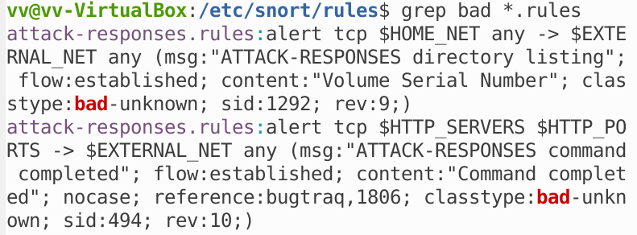
Grep a Fixed Pattern
Search for the word bad in some files!
man grep to learn more about grep

Slide 9
Grep a Fixed Pattern
Search for the word bad in some files!

Slide 10
Signatures
A signature is a cryptographic sum of a message
It is very sensitive to change in the message.
message
Signature (hexadecimal)
Hello world - b94d27b9934d3e08a52e52d7da7dabfa
Hello wirld - f50cbbeb31a1e8d68d21b83c38378cac
One character difference creates a completely new signature

Slide 11
Testing Signatures
Use the signature_hash_list.txt and ciphor to find which messages in the signatures folder have been modified. There are 5.
Python ciphor.py –f message.txt -S

Slide 12
Summary
Signatures offer a means to detect changes in a message
Signatures most often use a hexadecimal format
Can you think of one problem with Signatures?

